Slide 1
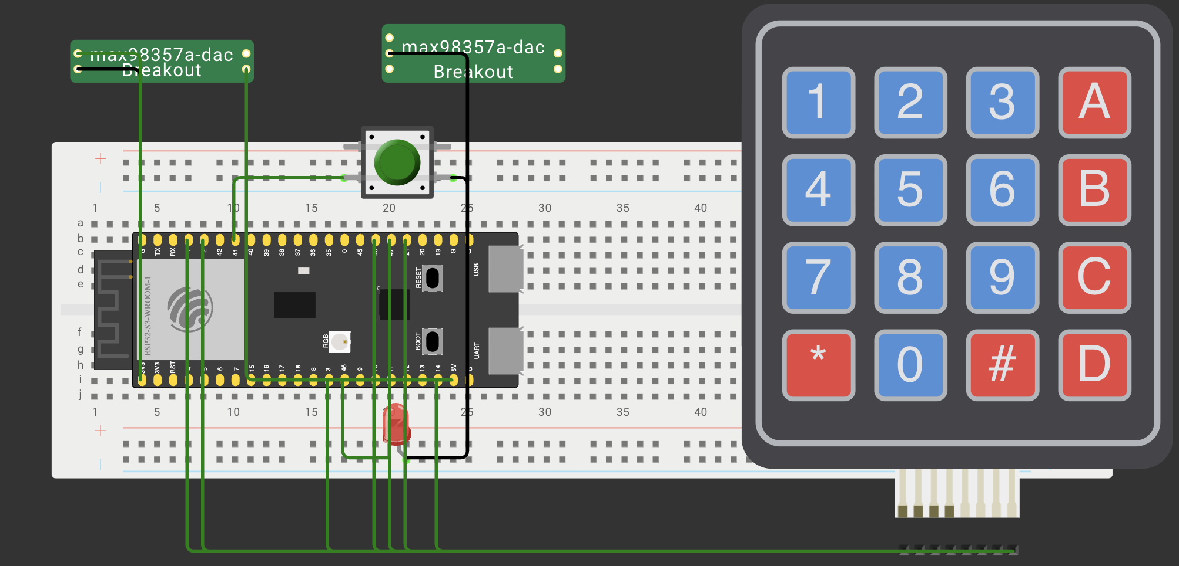
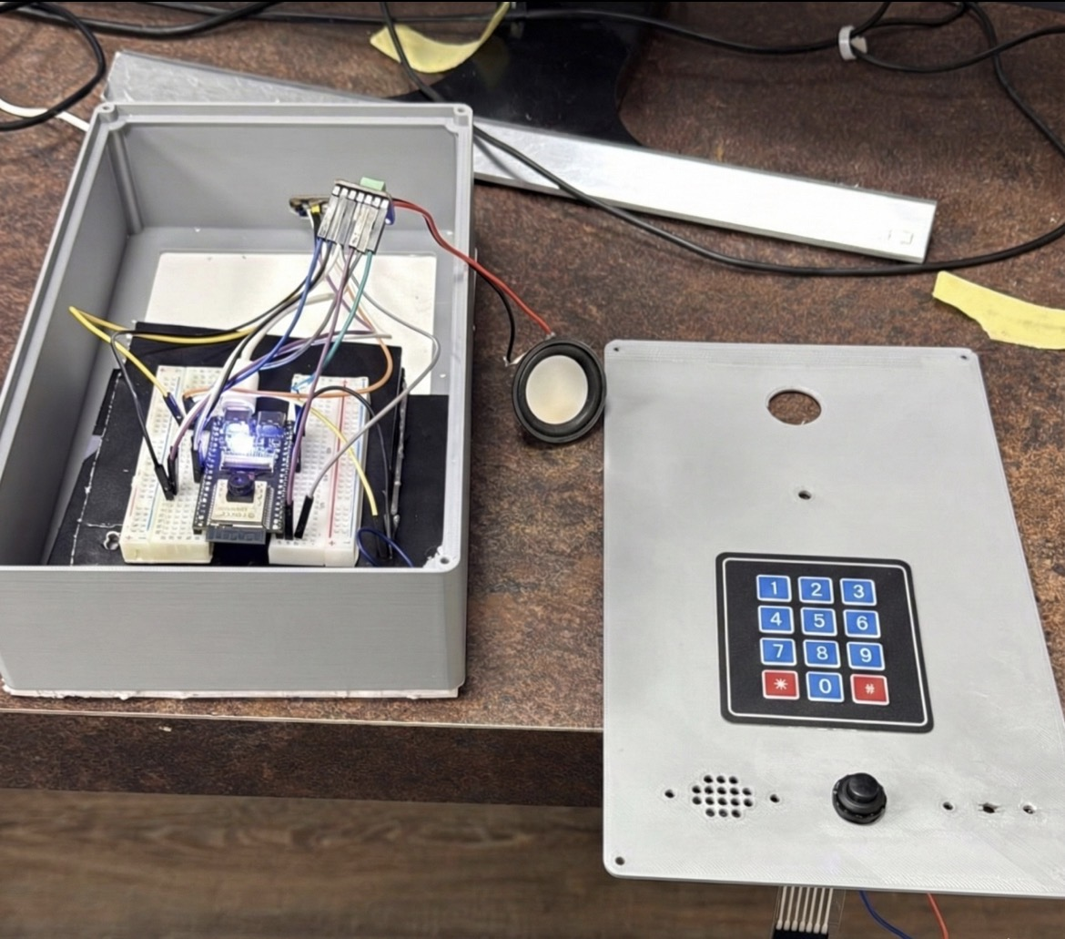
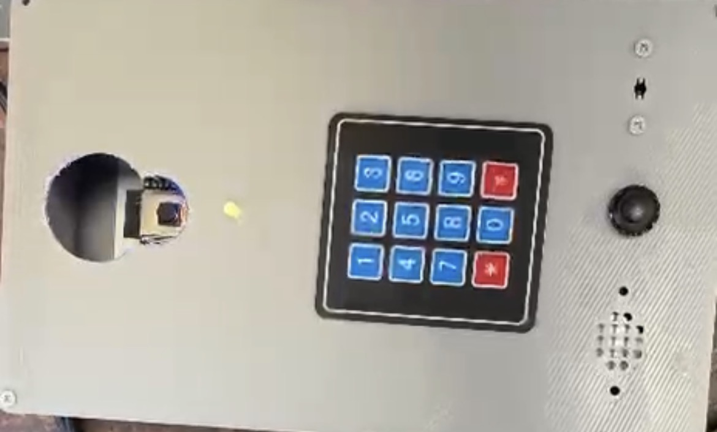
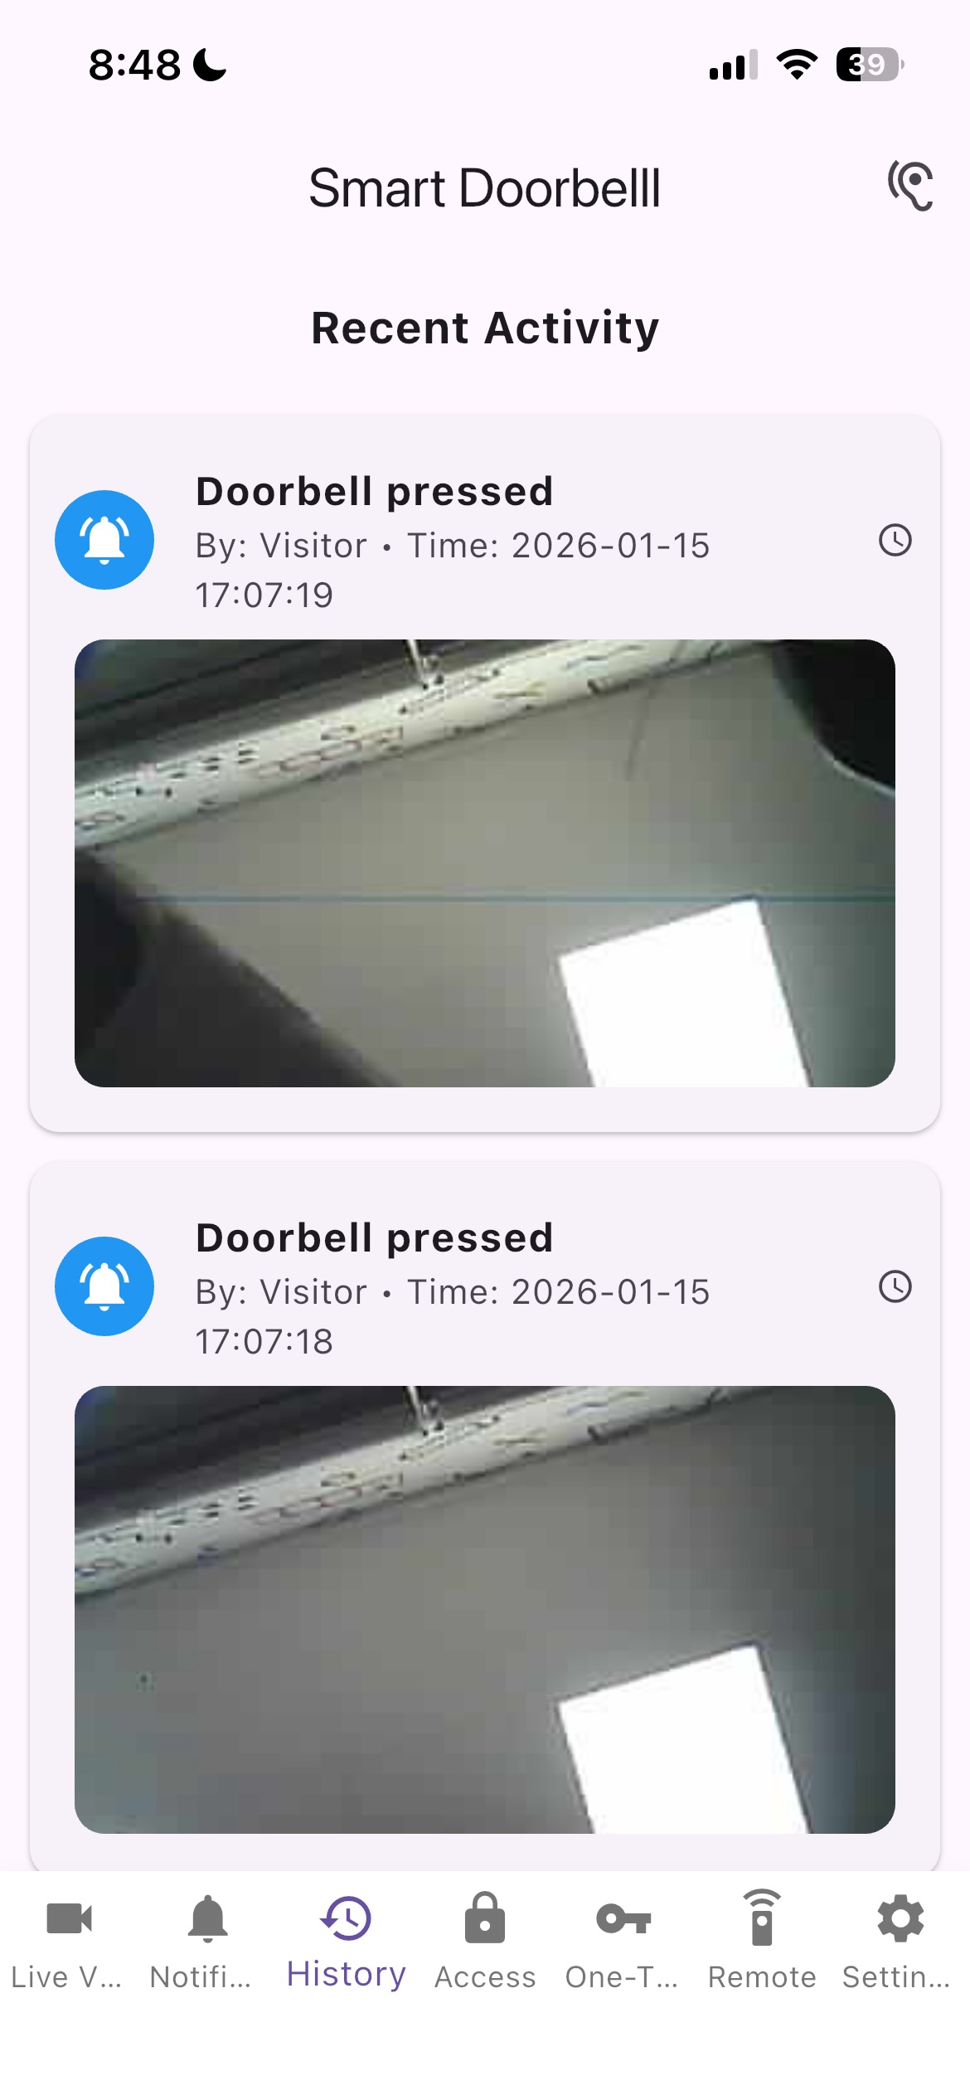
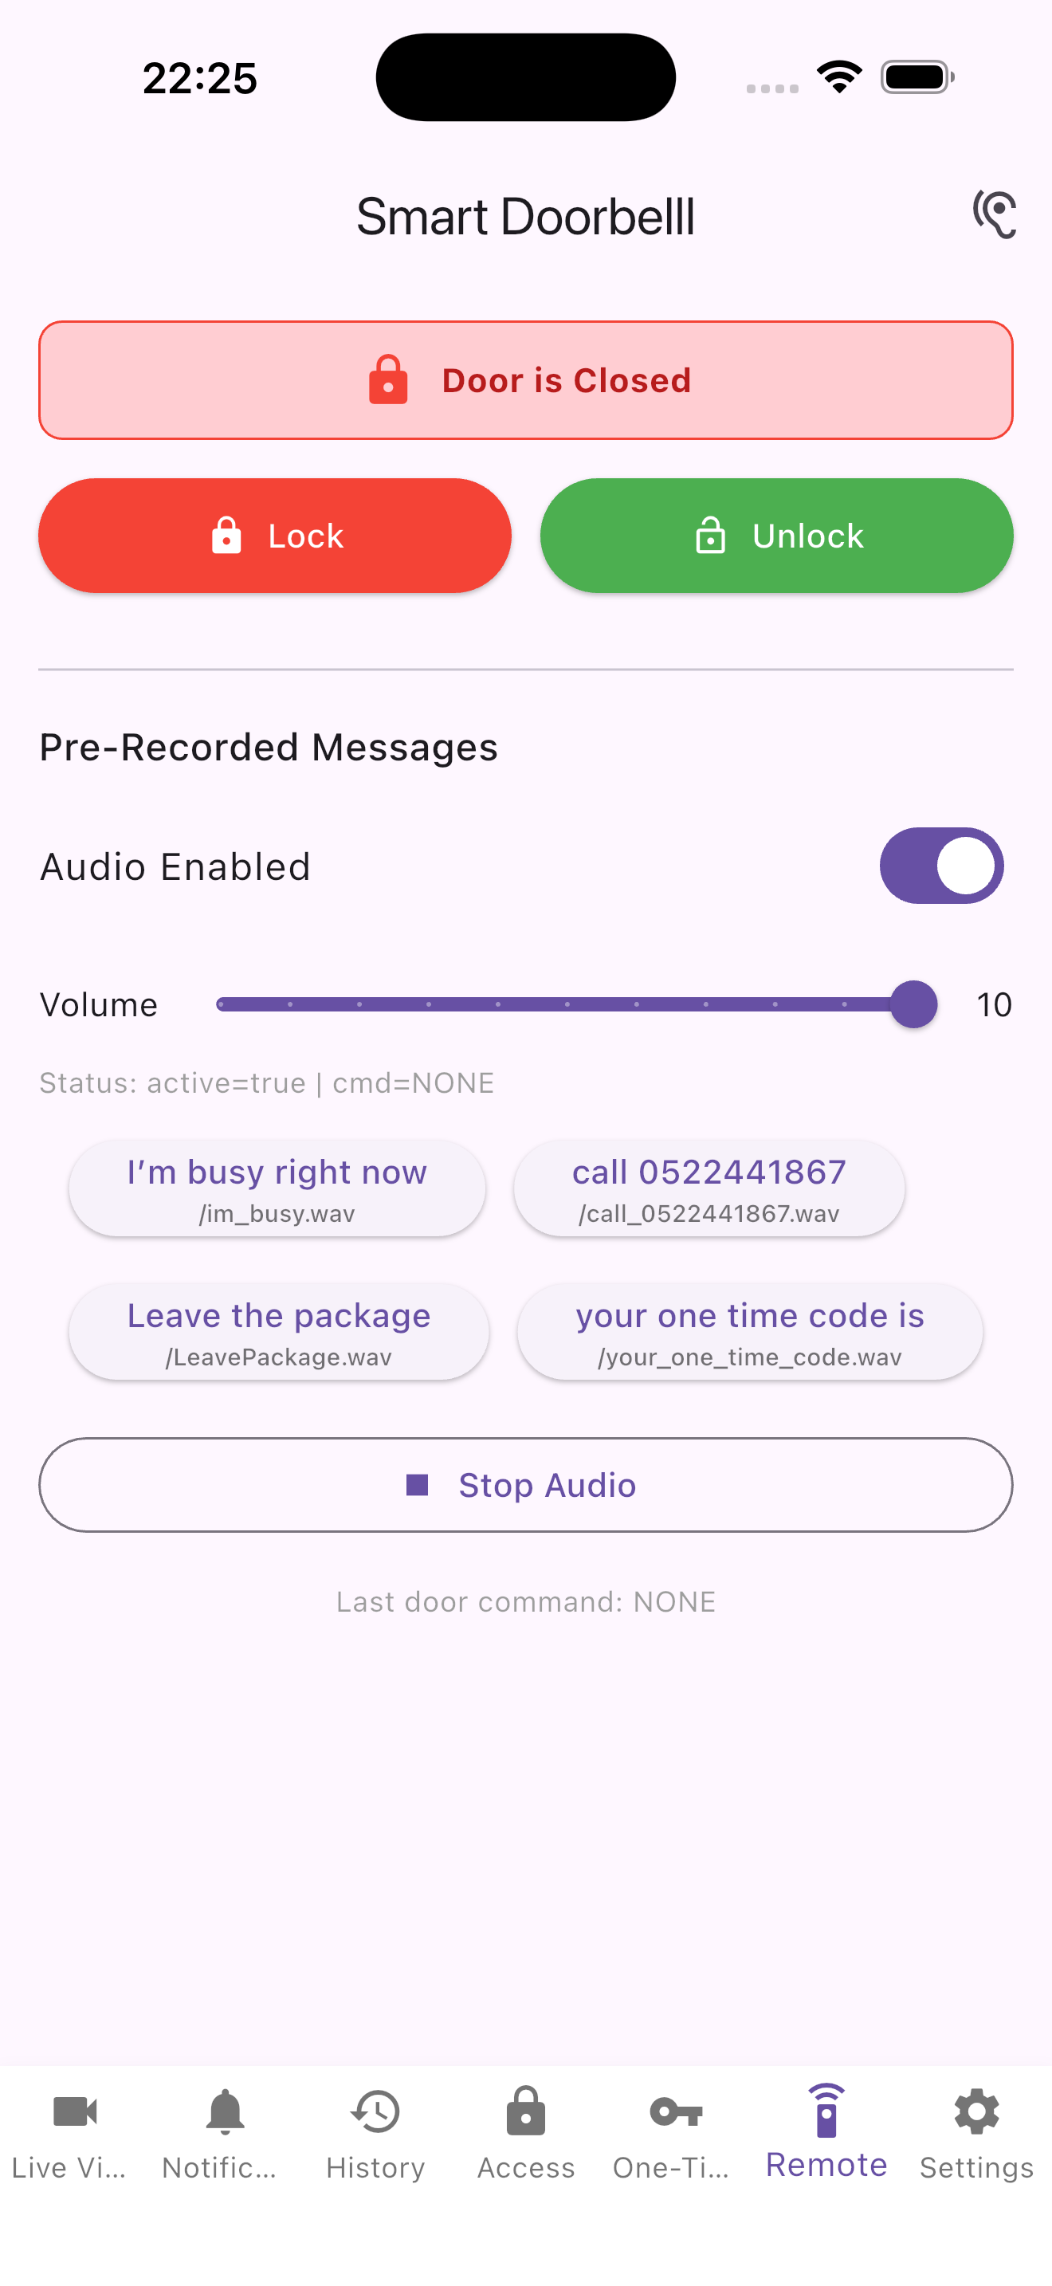
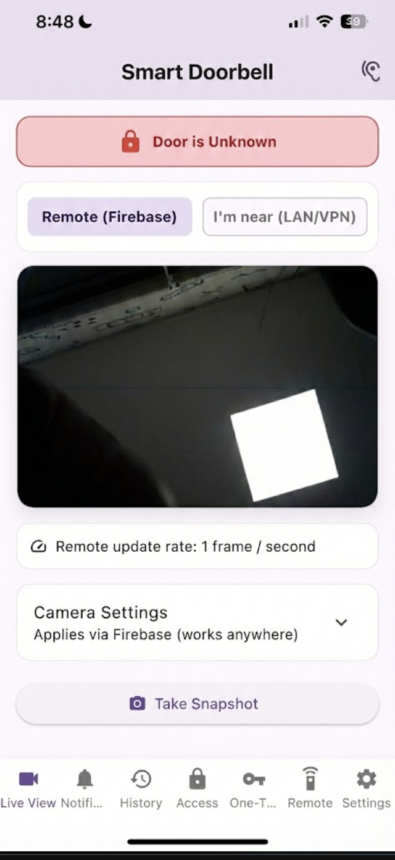
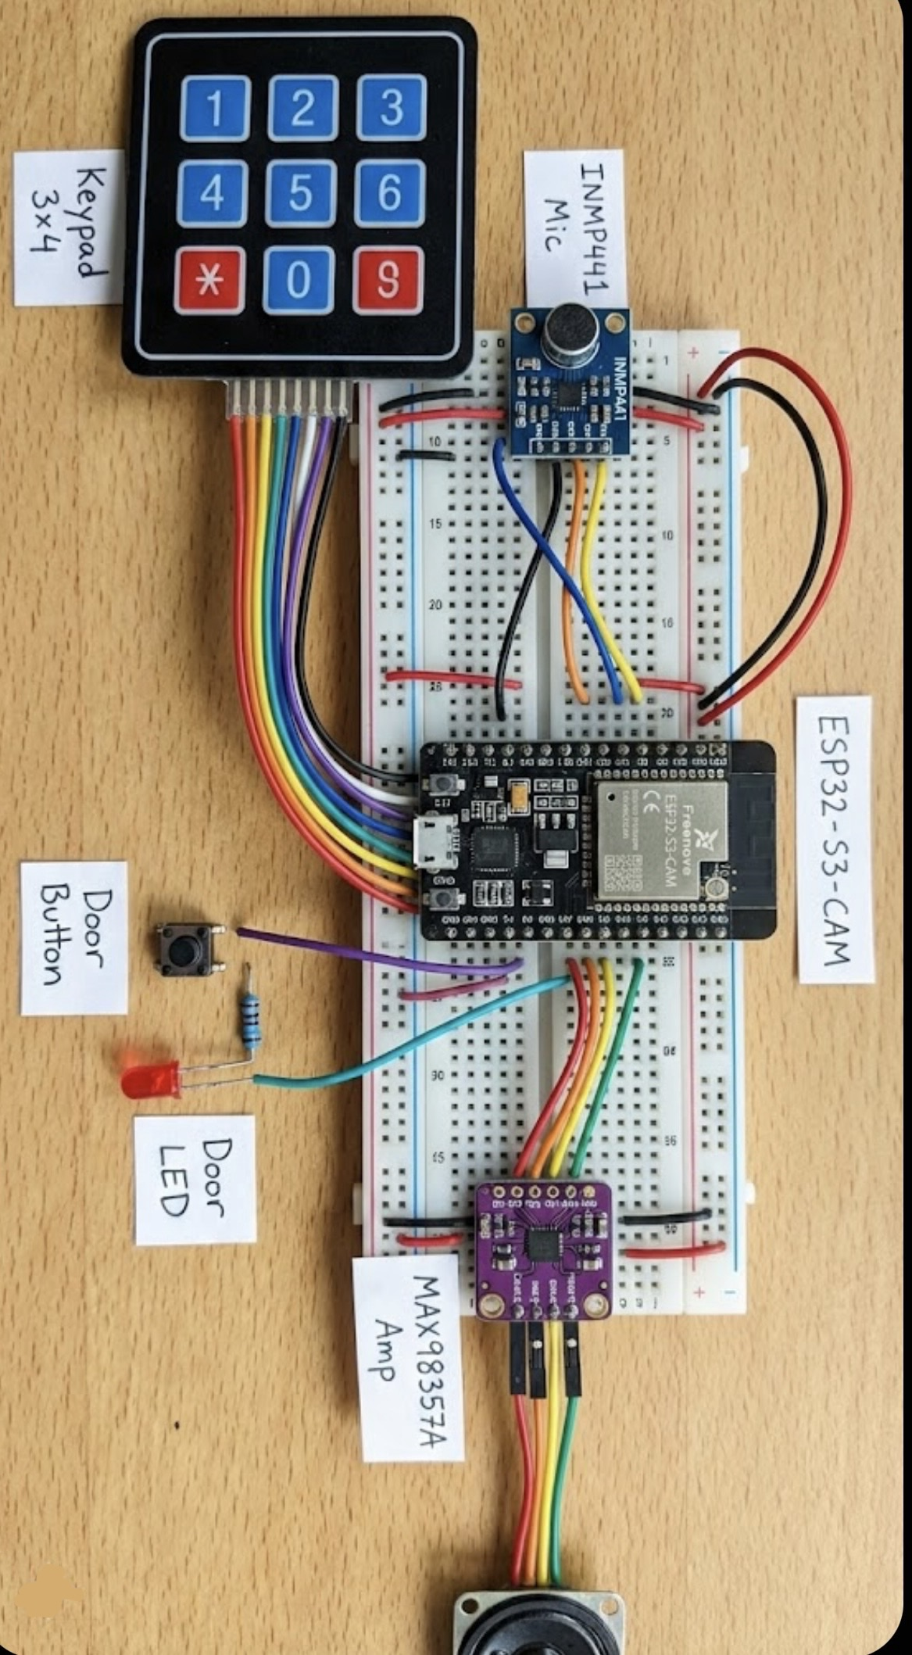
Smart Doorbell
See, verify, and unlock remotely.
Problem: When away, homeowners miss door events and can’t verify visitors or control access securely.
Project: Smart Doorbell is an ESP32-S3-CAM + Firebase + Flutter system for remote door monitoring and control.
Main features : Snapshot-on-press with instant alerts + event history, Live/semi-live viewing with two-way talk, Secure access control (one-time codes, remote unlock, auto-relock, and PIN lockout).
Uniqueness: Offline-safe capture with queued cloud sync and built-in security policies to prevent misuse.
Wiring Digram
Physical Prototype
Flutter_app
Team members : Haneen Masarwe, Mohamad Amer, Malak Sulieman
Lecturer: Itai Darban Instructor :Tom Sofer

